Slide 1
Tree-Based Models
Brandon Chung, Chi Hang (Philip), Jiaxin Zheng, Ron Balaban, Yanyi Li

Slide 2
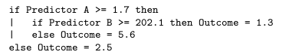
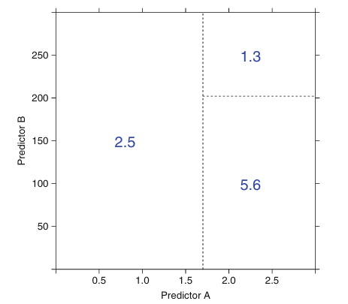
Basic Structure
One or more nested if-then statements for predictors that partition the data
Predictor A >= 1.7
Yes
Predictor B >= 202.1
No
Yes
No
2.5
5.6
1.3

Slide 3
Terminology
Predictor A >= 1.7
Nodes = Decision Points
Root Node = First decision/ First node
Terminal Nodes (leaves) = Outcomes
Can be function of predictors
Branches = Segments of the trees that connect the nodes
Split = Area in a tree where one node leads to more than one branch
Yes
Predictor B >= 202.1
Yes
No
No
2.5
5.6
1.3

Slide 4
Single Tree Model Pros/Cons
Pros:
Highly interpretable and easy to implement
Handle many types of predictors (sparse, skewed, continuous, categorical, etc.) without preprocessing
Model can handle missing data - conduct feature selection implicitly
Cons:
Model Instability ( slight changes in data drastically changes the structure of the tree or rules)
Less-than-optimal predictive performance (rectangular regions of outcome values)
- Cons addressed by ensemble methods that combine many trees

Slide 5
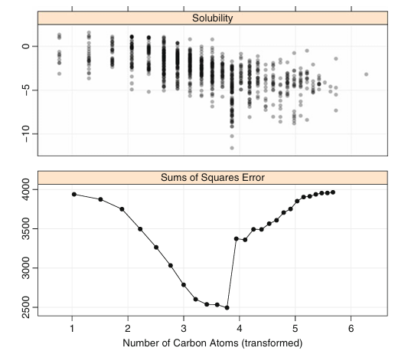
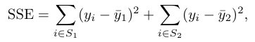
Constructing (Growing the tree)
Classification and Regression Tree (CART)
Start with the entire data set, S, and searches every distinct value of every predictor to find the predictor and value where the overall sums of squares error is minimized to partition the data into two groups (S1 and S2)
When done multiple times this is known as “Recursive Partitioning”
Recursive partitioning typically continues until a threshold, such as 20 partitions

Slide 6
Pruning
Cost-complexity tuning - find the “right-sized tree” with the smallest error rate.
Penalize error rate using size of the tree:
To find the best pruned tree:
Evaluate the SSE values for a sequence of Cp values -> generates multiple SSE values that we can apply a cross validation or one-standard-error rule on.
One-Standard-Error Rule = Find the smallest tree that is within one standard error of the tree with smallest absolute error.
Cp is complexity parameter - used to penalize the SSE, smaller values produce more complex models, larger values produce less complex models.

Slide 7
Pruning (cont.)
Alternatively to the one-standard-error rule:
Choose the value of the Cp associated with the smallest possible RMSE value from the cross-validation profile.

Slide 8
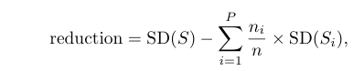
Regression Model Trees
Combines decision tree with linear regression at the nodes. This allows for better predictive accuracy as the outcome is more dynamic and able to capture extremes better.
Splits similarly done, but are created using the expected reduction the node’s error rate:
This metric determines if the total variation in the splits, weighted by sample size is lower than in presplit data
The split associated with the greatest reduction is chosen, and linear models are created within the partitions.

Slide 9
Regression Model Trees (Cont.)
Smoothing to prevent overfitting: “Recursive Shrinking”
When producing an output, starting at the appropriate terminal node, the linear regression used is a combination of all the regression models passed on the path to the terminal node.
Pruning: Starting at the terminal nodes, adjusted error rates with and without the sub-tree is computed, and if the sub-tree does not decrease the adjusted error rate it is printed from the model.

Slide 10
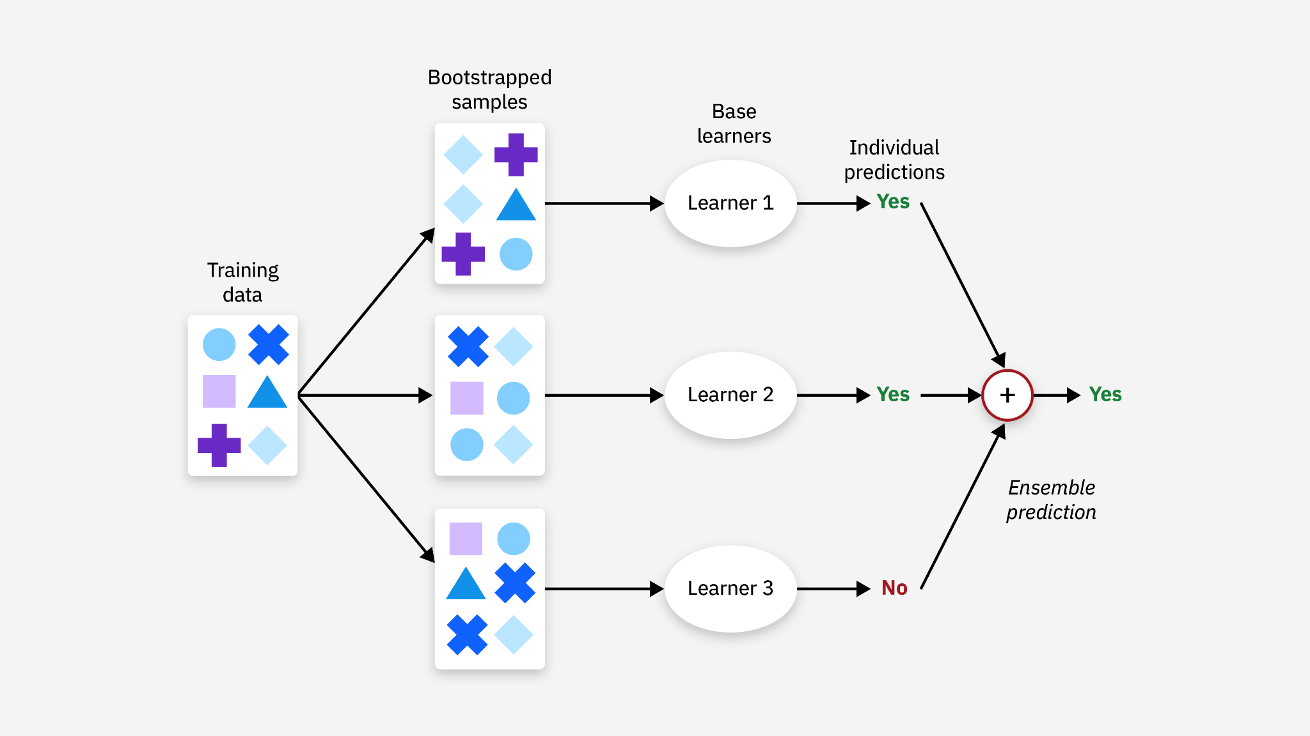
Bootstrap Aggregating (Bagging)
Use Bootstrapping to create N number subset of training data with replacement
Parallel model training
Creates an ensemble by averaging all the models predictions to reduce overfitting
Advanced version = randomForest
Advantages:
1) Reduces variance
2) Reduce overfitting

Slide 11
Bootstrapping
Bootstrap Sampling (Bootstrapping)
- Create training data from original data using a random sampling with replacement.
- Each random selection could occur any number of times.
- New dataset used for training, while the original data, un-selected for training, is used for CV.
- Compared to CV, this method is faster/simpler, and is better at estimating model performance for small datasets.
Notes:
RB

Slide 12
Aggregating
Each bag is used to train a separate model
Each model is trained in parallel
All the prediction results are averaged to become the final prediction

Slide 13
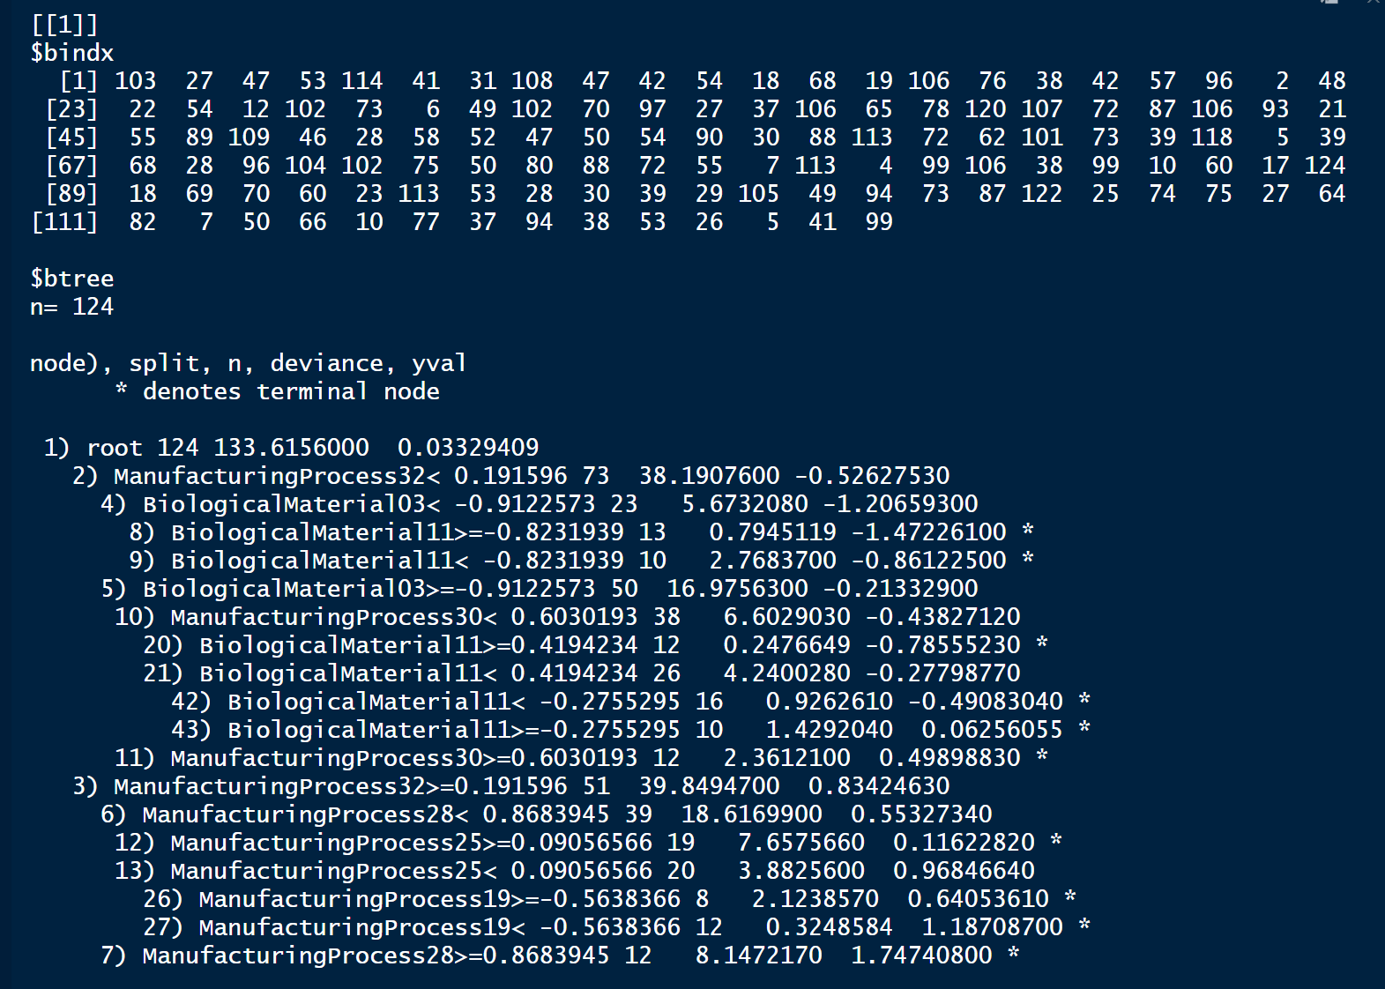
Bagging
Coding Example:
Data source: ChemicalManufacturingProcess
library(ipred)
bagged_Tree<- ipredbagg(
chem_train_y,
chem_train_x, nbagg=25)
Indices for rows that are selected
Splitting parameters for Tree #1

Slide 14
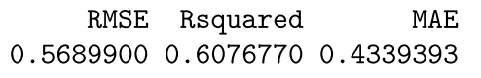
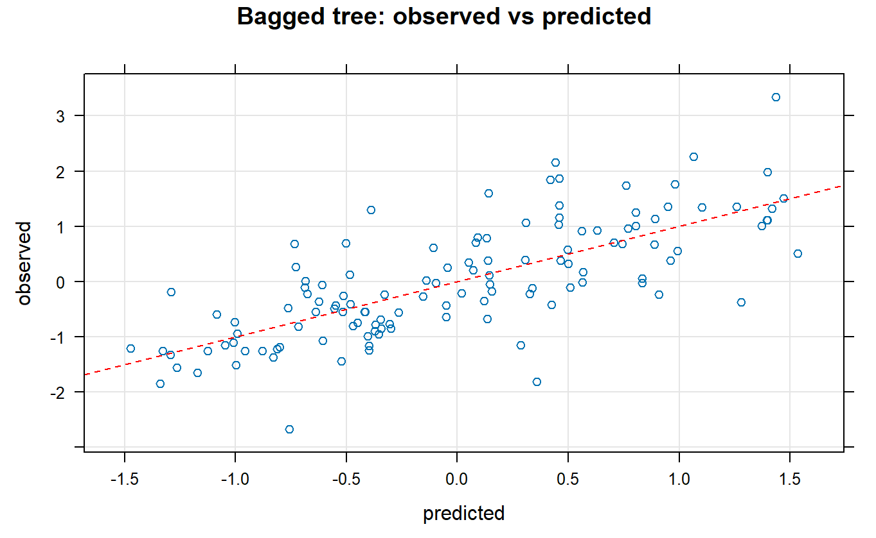
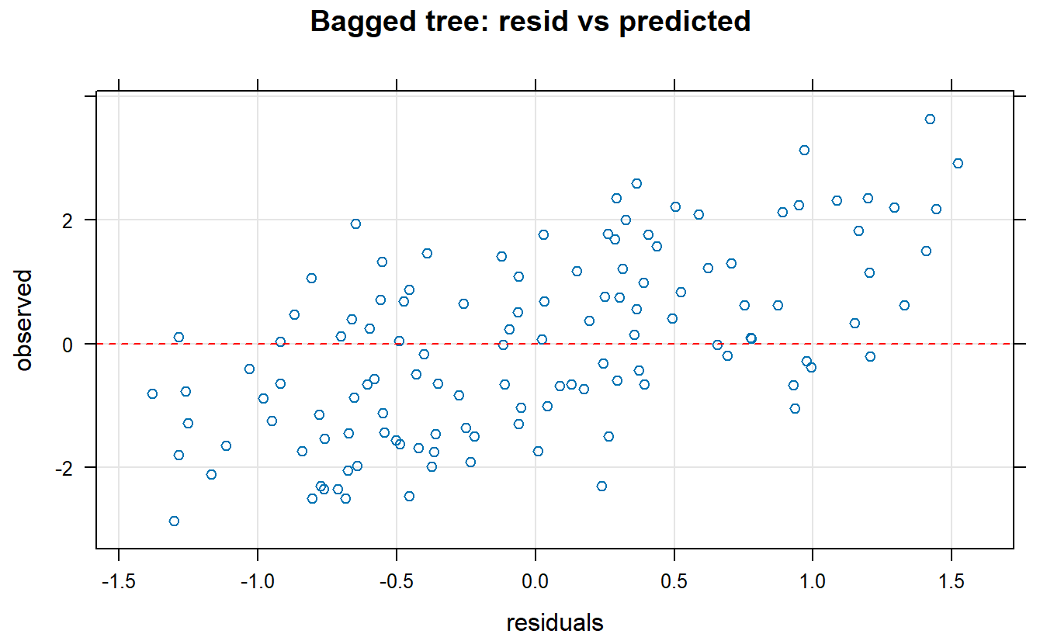
Prediction diagnostic
results:

Slide 15
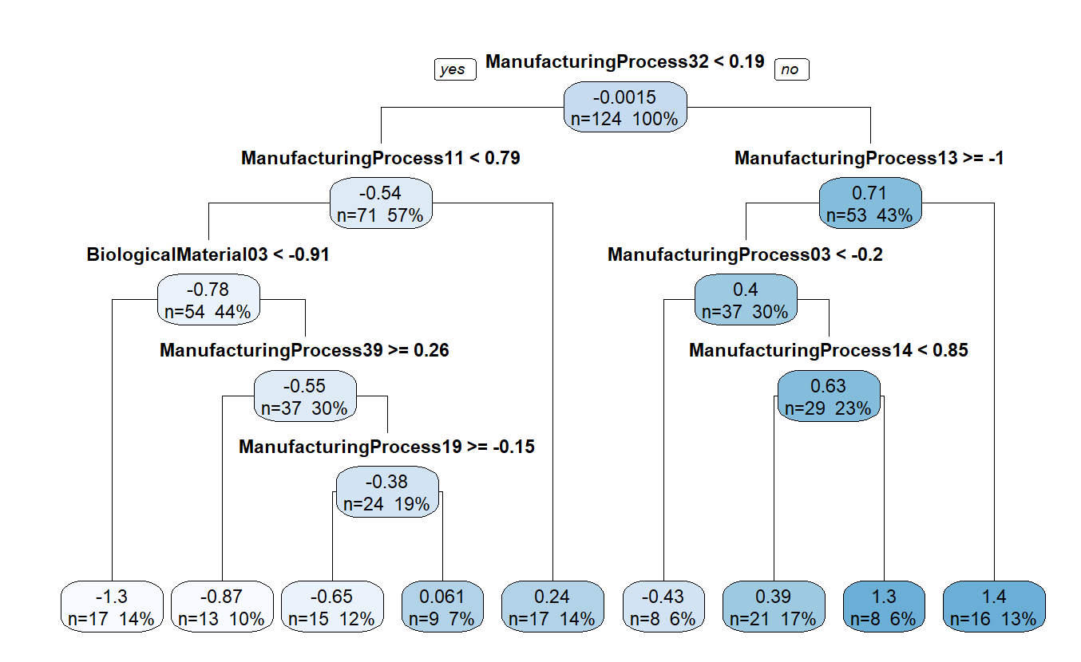
Rule-Based
tree model:
The “Separate and Conquer” methodology proposed by Holmes et al. (1993)
Step 1: Build a tree model
Step 2: Extract a single rule that has the most coverage, which is the number of samples from the training data that follow this path in the tree model.
Step 3: Remove the training data covered by the rule selected. Repeat step 1-2.
Step 3: Collect and rank each rule sequentially..
Step 4: These steps repeat until all training data are covered by at least one rule.
Step 5: When a new test sample is applied to this model, the linear regression model of the first sequentially collected set of rule that matches the best is used to evaluate the new test sample.
The more advance version of rule-base is Cubist.
Each leaf node has one linear regression model

Slide 16
Rule-Based model
Coding example:
M5Rules from Weka package uses similar approach for tree modeling:
It builds a decision tree using the “Divide-and-Conquer” methodology to recursively splits the data based on feature conditions (e.g. pressure, temperature)
It assigns linear regression models at the leaves (terminal points of a tree)
Extracts the rules from the tree model using the “Separate-and-Conquer” methodology
When predicting for new data and multiple rules apply to the new data, the one with the lowest estimated error is used.

Slide 17
Rule-Based model
Coding example:
m5rules<- train(x= chem_train_x,
y= chem_train_y,
method = 'M5Rules',
trControl = trainControl(method='cv'),
control = Weka_control(M=10))
*The M parameter controls the minimal number of instances(data points) needed to reach a node in order for it to keep splitting. If the number of instances do not meet the M value, the node becomes a leaf node (terminal node), stopping to split further.
Small M will make the mode too specific–overfitting (too many splittings)
Large M will make the mode too general–underfitting (too many leaf nodes)

Slide 18
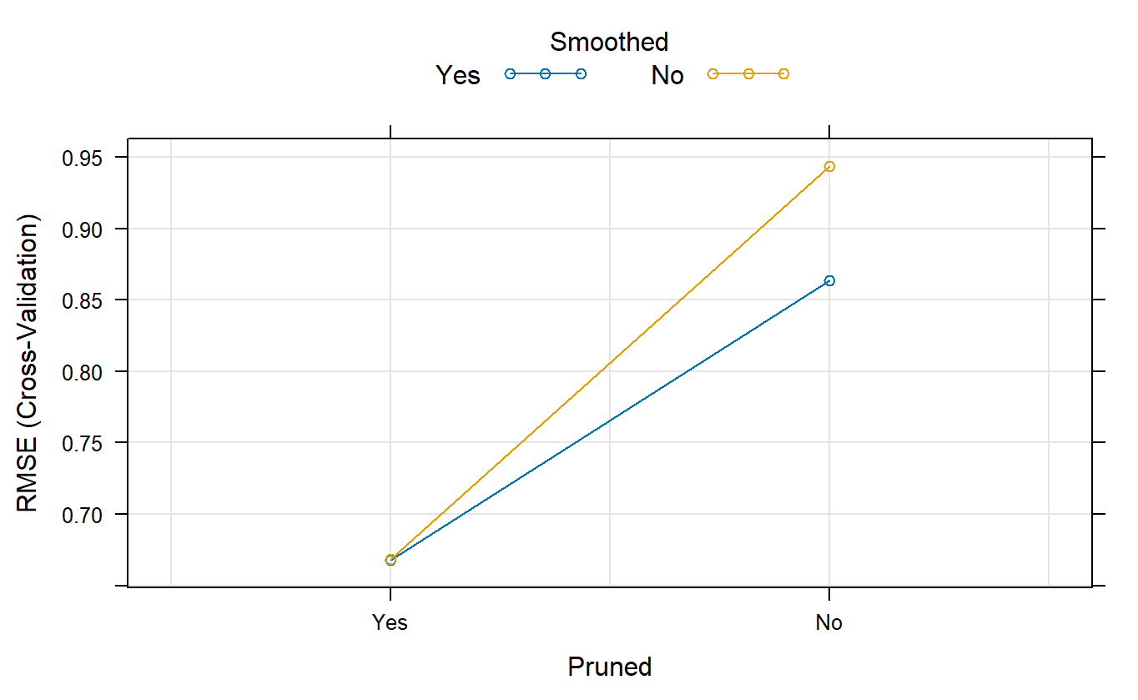
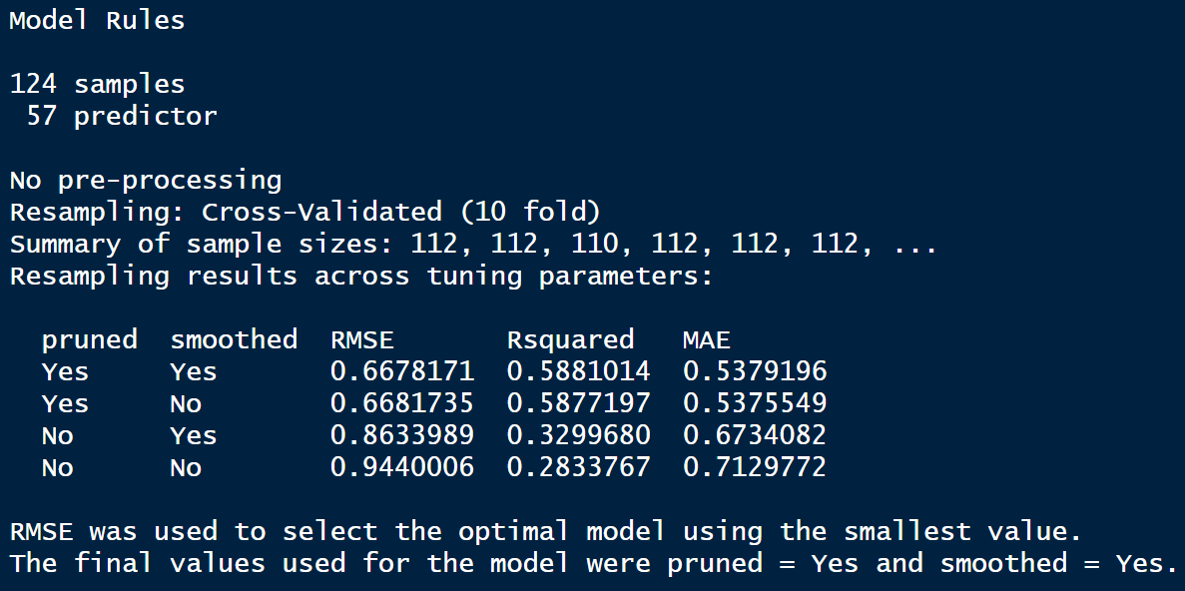
Rule-Based model:
Model Selection

Slide 19
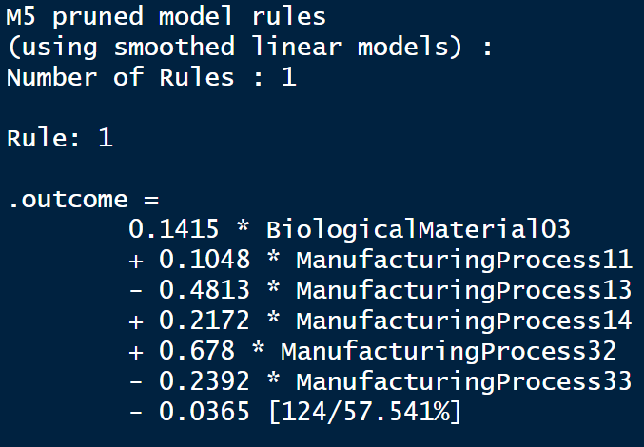
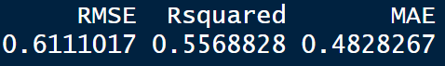
Rule-Based model:
What is inside the model?
The final model has only one rule with the largest coverage for the new test data.
The rule is associated with a linear regression equation, which is used to predict the outcome for the response variable:
57.5% of the test data is covered by this rule.

Slide 20
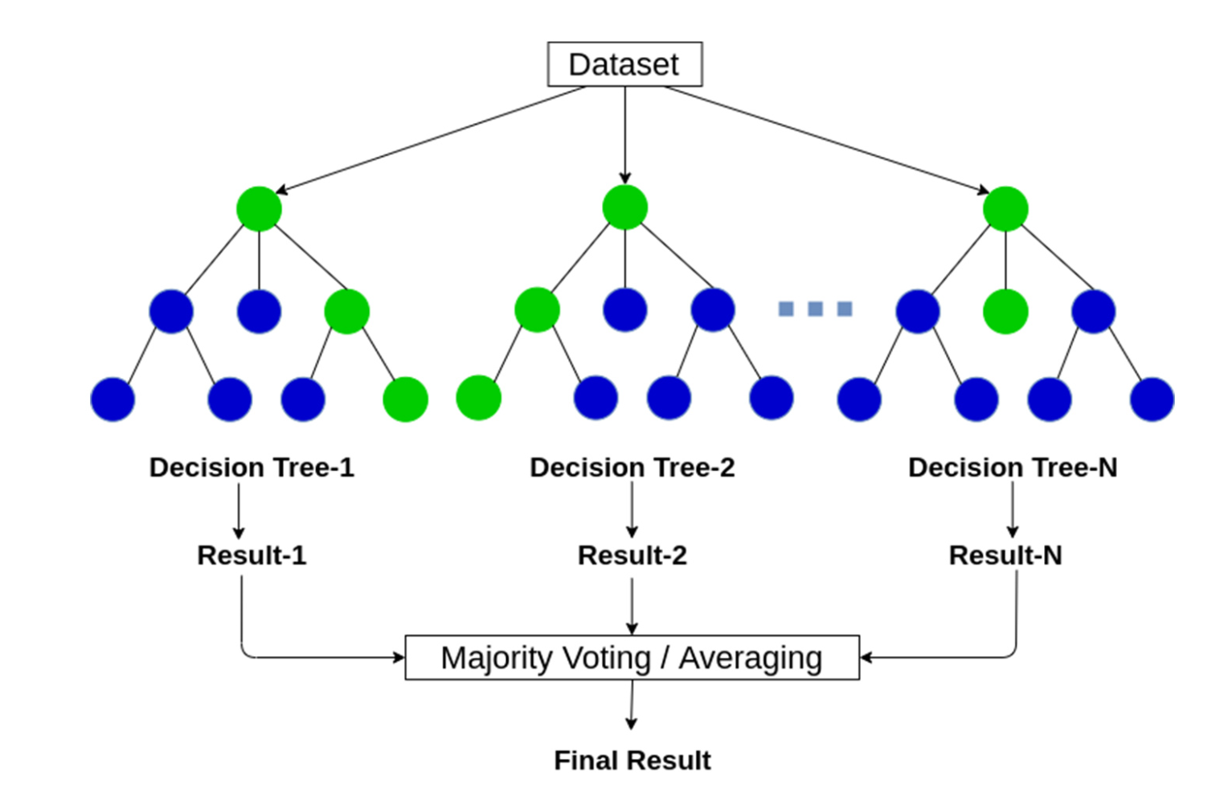
Random Forest
A Random Forest is an ensemble learning method that builds multiple decision trees and combines the output of multiple decision trees to reach a single result.
Handles both classification and regression problems.

Slide 21
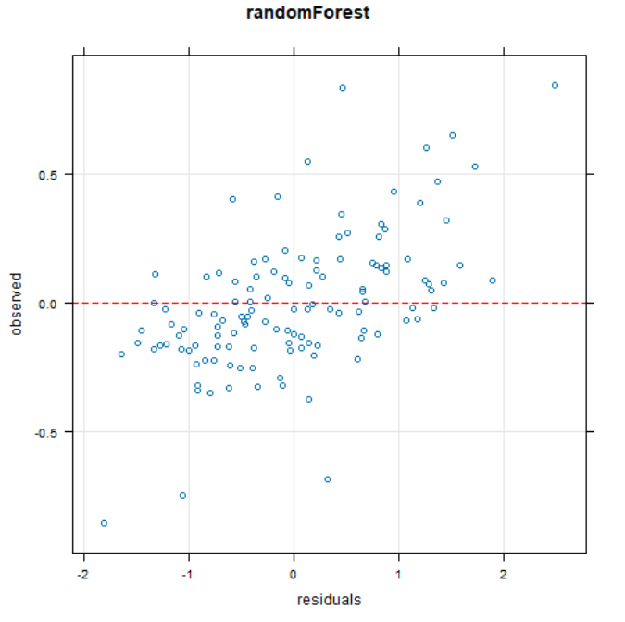
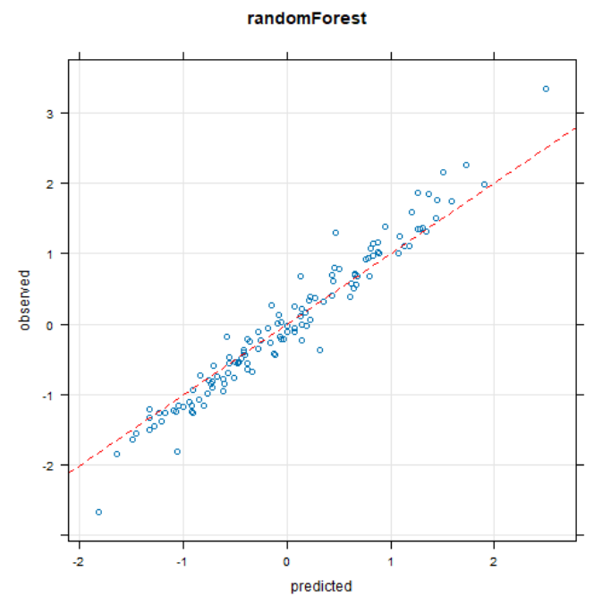
Why Add Randomness?
Random Forest reduce tree correlation by selecting a random subset of predictors at each split.
By lowering the correlation, it leads to better variance reduction,and improved accuracy.
It reduces overfitting and improves predictive accuracy, particularly when the individual trees are uncorrelated with each other.

Slide 22
How Random Forests Work
01
02
03
Bootstrap Sampling
Random Feature Selection
Ensemble Prediction
Each decision tree in the forest is trained on an unique bootstrap sample of the original data.
One-third of sample will set as test data, known as the out- of- bag(OOB) sample.
At each node, a random subset of predictors will be selected.
Among the predictors, RF will determine the ones with the less MSE(or error) as the criterion for a split at that node.
After each tree has been trained, the Random Forest averages the predictions from all the trees to make a final prediction:
For classification: The final prediction comes from all the trees’ majority votes.
For regression: The final prediction is the average of all tree predictions.

Slide 23
Random Forests Pros/Cons
Pros:
High predictive accuracy and reduced risk of overfitting and bias compared to a single decision tree.
Provides flexibility: can handle both regression and classification.
It maintains accuracy even when a portion of the data is missing.
Works well with large and complex datasets.
Cons:
Time- consuming: Can be slow to process data when it is computing data for each individual decision tree.
More complex when compared to a single decision tree.
Require more resources to store the data.

Slide 24
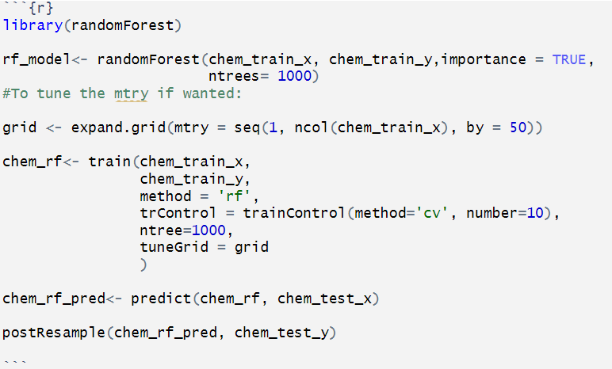
Example
mtry: Number of predictors randomly selected at each split.
ntree : Number of trees created. Usually use at least 1000.

Slide 25
Cubist
Cubist is a machine learning technique that extends regression trees by incorporating rule-based models and instance-based learning to improve predictive accuracy.
Rule-based: Create explicit "if-then" rules to make predictions.
Instance-based: Make predictions based on past examples (instances) rather than general rules.
It was developed by Ross Quinlan, the same researcher who created C4.5 and M5 model trees.

Slide 26
Key Characteristics
Regression Tree with Linear Models
Unlike traditional decision trees that predict a single value per leaf, Cubist builds a regression model at each leaf.
Each rule (or tree split) corresponds to a linear equation instead of a constant value.
Rule-Based Refinement
After constructing the regression tree, Cubist extracts rules from it.
Each rule consists of conditions (if-then statements) and an associated linear regression model for prediction.

Slide 27
Key Characteristics
Instance-Based Correction (Neighbors)
After making an initial prediction, Cubist adjusts it based on similar past cases.
This nearest neighbor correction helps reduce errors and improve generalization.
Handles Missing Data Well
Uses surrogate splits to deal with missing values.

Slide 28
How the Cubist Works
01
02
03
Builds a Regression Tree
Converts the Tree into Rules
Applies Nearest Neighbor Adjustments
Uses recursive partitioning to create splits based on features that minimize error.
At each leaf node, instead of assigning a single value, it fits a linear regression model.
Each path from the root to a leaf becomes an if-then rule.
The corresponding linear model is stored for that rule.
During prediction, it finds similar instances in the training set.
The final prediction is adjusted based on these neighbors.

Slide 29
Strengths and Weaknesses
Pros:
Interpretability (clear rules).
Good performance with small-to-medium datasets.
Robust to irrelevant features.
Cons:
Not ideal for very high-dimensional data (like deep learning).
Limited to regression (no native classification support).

Slide 30
When to Use Cubist?
Best for:
Structured datasets with mixed linear & non-linear relationships.
Situations where interpretability is important.
Forecasting tasks that benefit from instance-based corrections.
Avoid If:
Need a pure deep learning approach.
Have very high-dimensional sparse data (e.g., text mining).
Want a model that is natively available in Python (Cubist is mainly in R).

Slide 31
Example
# Load dataset (using Boston Housing data)
data <- MASS::Boston
# Define predictors and target variable
predictors <- data[, -14] # All columns except median house price
target <- data$medv # House price
# Train a Cubist model
cubist_model <- cubist(x = predictors, y = target, committees = 10) # Using 10 committees (boosting)
# Make predictions
predictions <- predict(cubist_model, predictors)
# Print model summary
summary(cubist_model)
The Cubist package in R directly implements the Cubist algorithm, making it easy to use.
Python does not have a direct Cubist package.

Slide 32
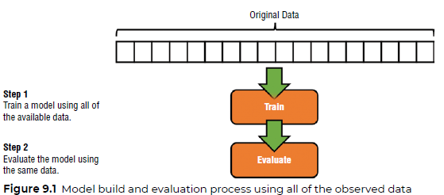
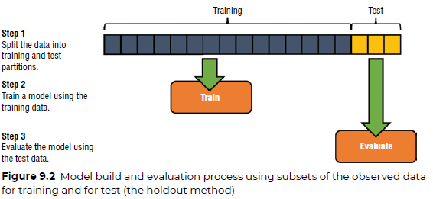
Estimating Future Model Performance
Goal: Use observed data to develop a model that best estimates the relationship between a set of predictor variables X and corresponding response values Y.
Relationship between X and Y is goodness-of-fit.
The difference between a model’s predicted response and observed response is resubstitution error.
Holdout Method: Train-Test Split Partitions (1/3 to 1/4)
Notes:
RB

Slide 33
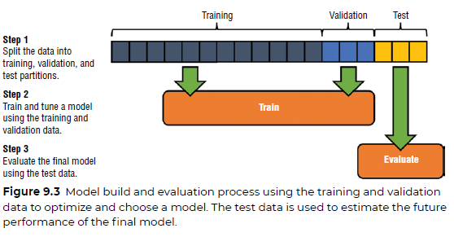
Estimating Future Model Performance
Partition the Training/Validation/Test sets as 50/25/25% respectively.
With small enough dataset, the random sampling approach used to generate training, validation, and test partitions could result in samples that don’t evenly represent class distribution of original dataset.
Notes:
RB

Slide 34
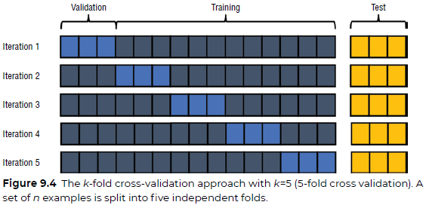
k-Fold CV
Repeatedly using different samples of the original data to train and validate a model. The performance of the model across the different iterations is averaged to yield an overall performance estimate for the model.
k-Fold Cross-Validation
- After the TTS, partition the training data equally
- For the first iteration, all instances labeled as
fold1 are held out, while the remainder of the data is used to train the model. The performance
of the model is then evaluated against the unseen data (fold1)
- Stratified CV: Ensure class distribution of each fold is representative of the overall distribution.
Notes:
RB

Slide 35
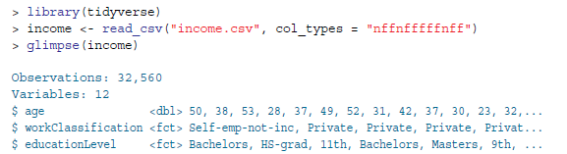
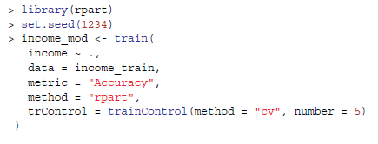
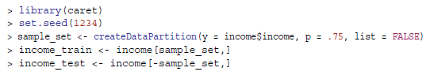
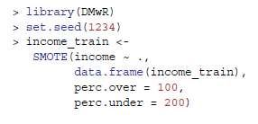
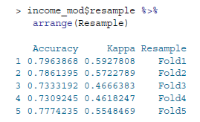
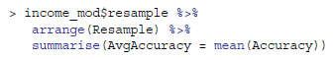
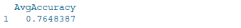
Code (K-Fold)
Import & view data
Train & validate the model. 5-Fold CV
Train/Test Split partition with caret(). Set seed for reproducibility
Balance imbalanced dataset with SMOTE()
View Accuracy
Notes:
RB

Slide 36
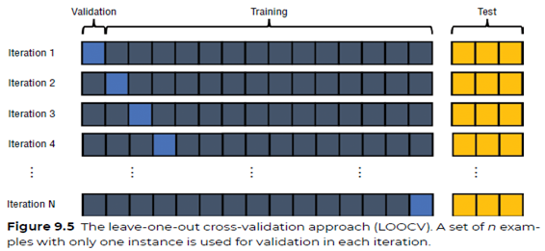
LOOCV
Leave-One-Out Cross-Validation (LOOCV)
- Functionally a k-Fold model with k sets.
- After the last iteration, we end up with n
estimates of the model’s performance from each of the iterations. The average of these
estimates is the estimate of model performance.
- Greatest amount of data trained, high accuracy.
- Deterministic: Same performance each run.
- Very high or infeasible computational cost.
Notes:
RB

Slide 37
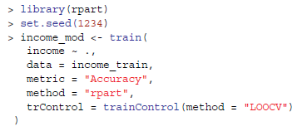
Code (LOOCV)
Import & view data
Train & validate the model. k-Fold CV
Train/Test Split partition with caret(). Set seed for reproducibility
Balance imbalanced dataset with SMOTE()
View Accuracy
Notes:
RB

Slide 38
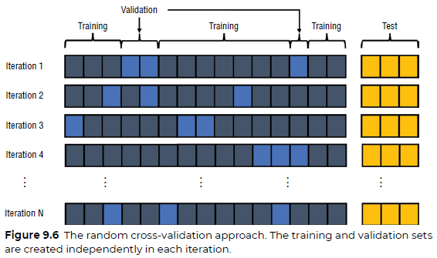
Random CV
Random (Monte Carlo) Cross-Validation
- Instead of creating a set number of folds, the random sample that determines validation is created each iteration.
- Random sampling without replacement
- Each random selection could occur any number of times.
- Major advantage over k-CV: size of the training
and validation sets is independent of the number of CV iterations.
Notes:
RB

Slide 39
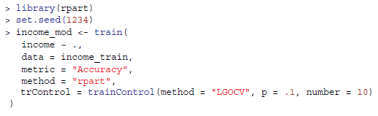
Code (RCV)
Import & view data
Train & validate the model. Randomly select 90% as training data, 10% as validation over 10 different iterations.
Train/Test Split partition with caret(). Set seed for reproducibility
Balance imbalanced dataset with SMOTE()
View Accuracy
Notes:
RB

Slide 40
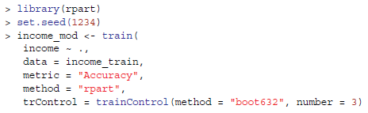
Code (Bootstrap)
Import & view data
Train & validate the model.
Train/Test Split partition with caret(). Set seed for reproducibility
Balance imbalanced dataset with SMOTE()
View Accuracy
Notes:
RB

Slide 41
Ensemble Methods
We might not find the optimal set of hyperparameters for a single model and even if we did, the model may not capture all the underlying patterns.
Instead of optimizing the performance of one model, use several complementary weak models to build a much more effective and powerful model.
Notes:
RB

Slide 42
Allocation Function: Algorithm that decides how much of the training data is assigned to each model in the ensemble.
Can assign all or part of the data to an ensemble model.
By varying a model’s input, we can control the learning/bias components.
Combination Function: Algorithm that decides how to reconcile and weigh different answers from different learners.
If the ensemble method consists of multiple of the same model, it’s homogenous.
If we combine varied models, it is a heterogeneous ensemble.
Notes:
RB

Slide 43
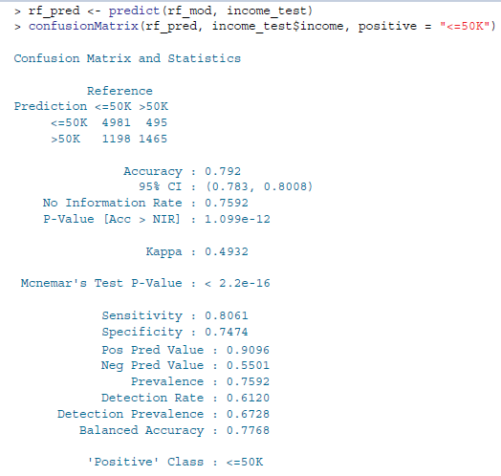
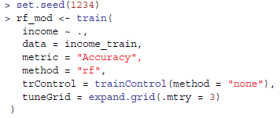
Code (Ensemble)
Train & validate the model: Random forest ensemble

Slide 44
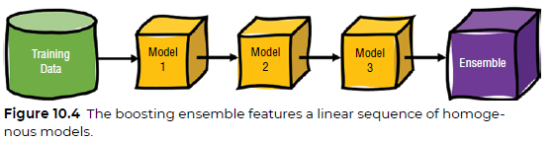
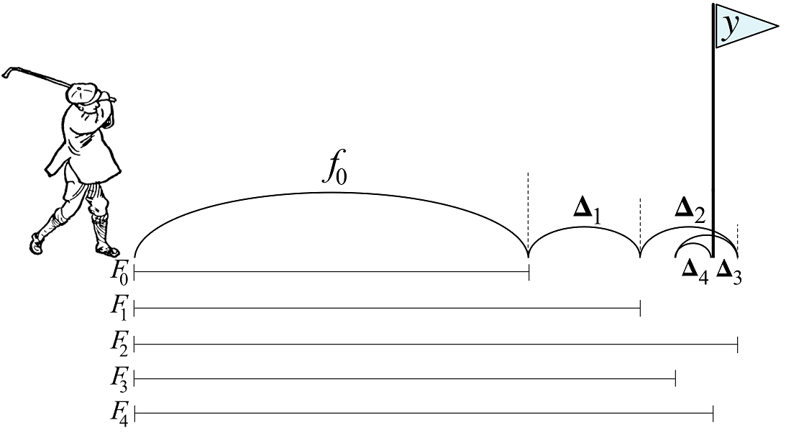
Ensemble: Boosting
Adaptive Boosting:
Homogenous sequential models. Within the sequence, each model attempts the performance of prior model by focusing on mistakes.
Each model is evaluated, scored, and shapes the future model in the ensemble. The combination functions considers a model’s performance for its influence.
Gradient Boosting:
Instead of correctly predicting prior mistakes, predict the residuals.
Notes:
One can think of boosting in terms of a golfer trying to hit a ball into a hole.
With adaptive boosting, the golfer makes an initial attempt to get the ball into the hole but misses. The golfer then continues to make successive attempts at getting the ball into the hole, all from the same starting position. The goal is to learn from previous attempts to get the ball into the hole with only one stroke.
With gradient boosting, instead of making all the attempts from the same starting location, the golfer makes each successive attempt from wherever the ball landed the previous time. Sometimes the golfer may fall short of the hole, and sometimes overshoot the hole. Each time, the focus is on the distance between where the ball landed in the previous attempt and the hole.

Slide 45
Adaptive Boosting (Adaboost)
Initial Fitting
Fit a classifier to the original dataset- the foundation for future estimators.
Weight Adjustment
Misclassified observations have their weights adjusted, for future classifiers to focus on them.
Re-weighting Instances
Re-weighted instances are passed to the next estimator in the sequence, until error reduction is minimized or the maximum number of estimators is reached.
Iteration Continuation
Each subsequent estimator is built based on the performance of the previous one.
The aim is to enhance accuracy by addressing the misclassified instances.
Notes:
RB

Slide 46
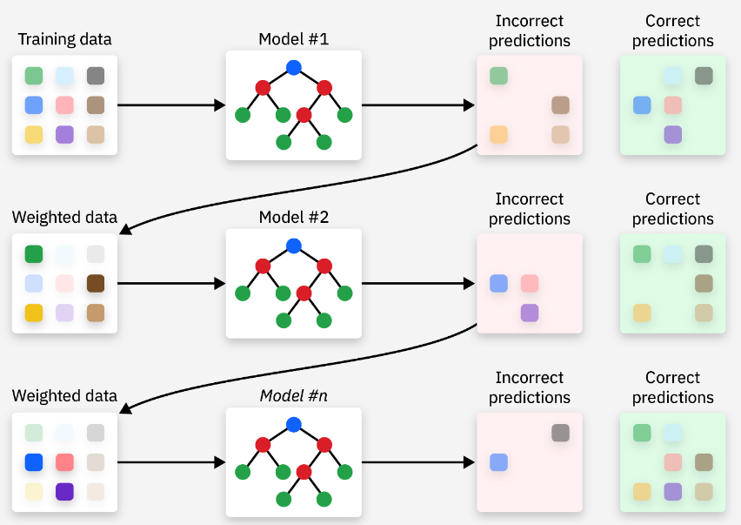
We opt out of hyperparameter tuning for our model, and thus avoid resampling.
Notes:
RB

Slide 47
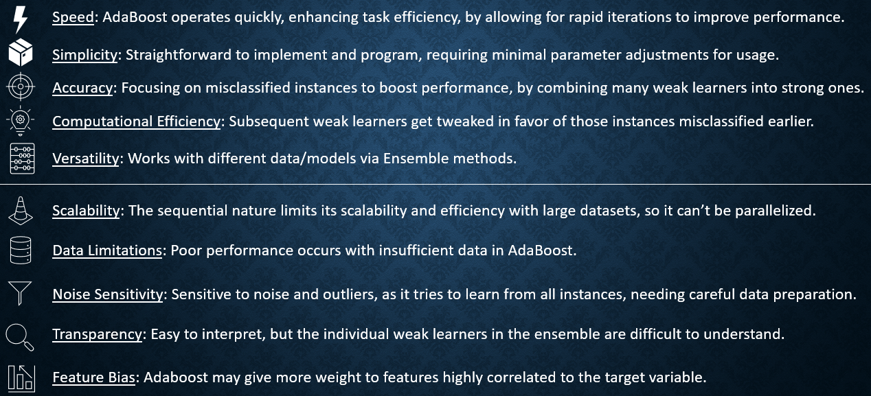
Adaboost Pros/Cons
Notes:
RB

Slide 48
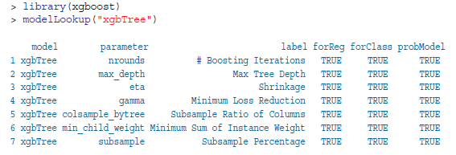
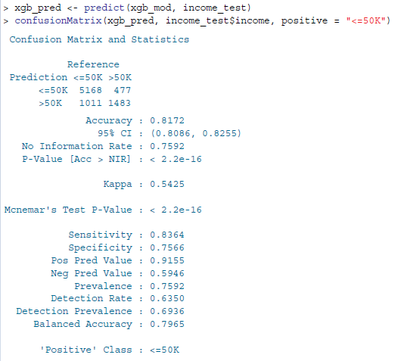
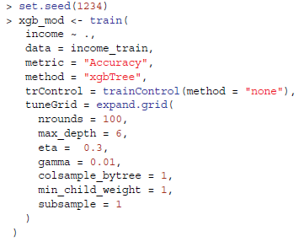
Code (XGBoost)
Evaluate model against test data.
Higher ‘nrounds’ = better performance, but overfit on training data.

Slide 49
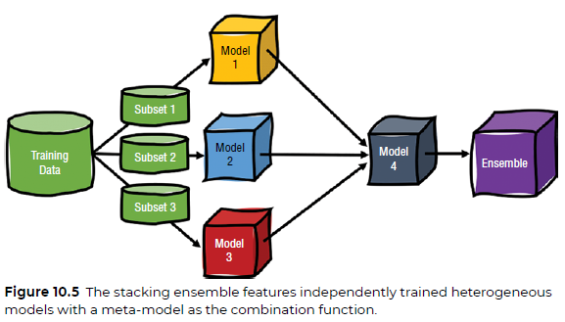
Ensemble: Stacking
Heterogeneous models, i.e. a k-NN, Naive Bayes, Linear Regression
Relies on several independent learners, whose predictions go to a combination function.
The final model that learns from outputs of other is a meta model.
When combining predictions of different models, ensure the base models have very low correlation- this tells us the models are good in different ways and don’t approach problems similarly.
Notes:
The combination function for a stacked ensemble is another machine learning algorithm that learns from the outputs of the other learners within the ensemble to decide on a final prediction. Model 4 is a machine learning model that takes the outputs of models 1, 2, and 3 as inputs in order to make a final prediction.

Slide 50
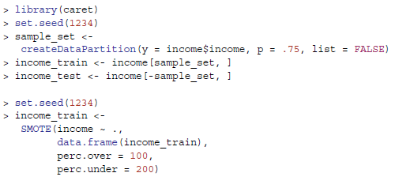
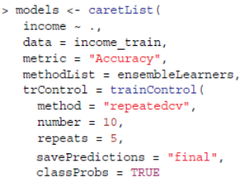
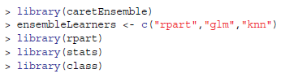
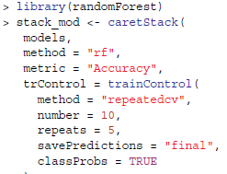
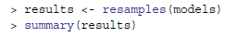

Code (Stacking)
Train model: 10-fold CV 5 times
Create learners: Decision Tree, Logistic Regression, KNN
Build meta model.
View Accuracy

